Slide 1


CREATEH
FEST
ER
Building a CHATBOT
on GOOGLE CLOUD
To support Women Entrepreneurs
MANSI MORE | AI ENGINEER | BE HUMANE

Slide 2
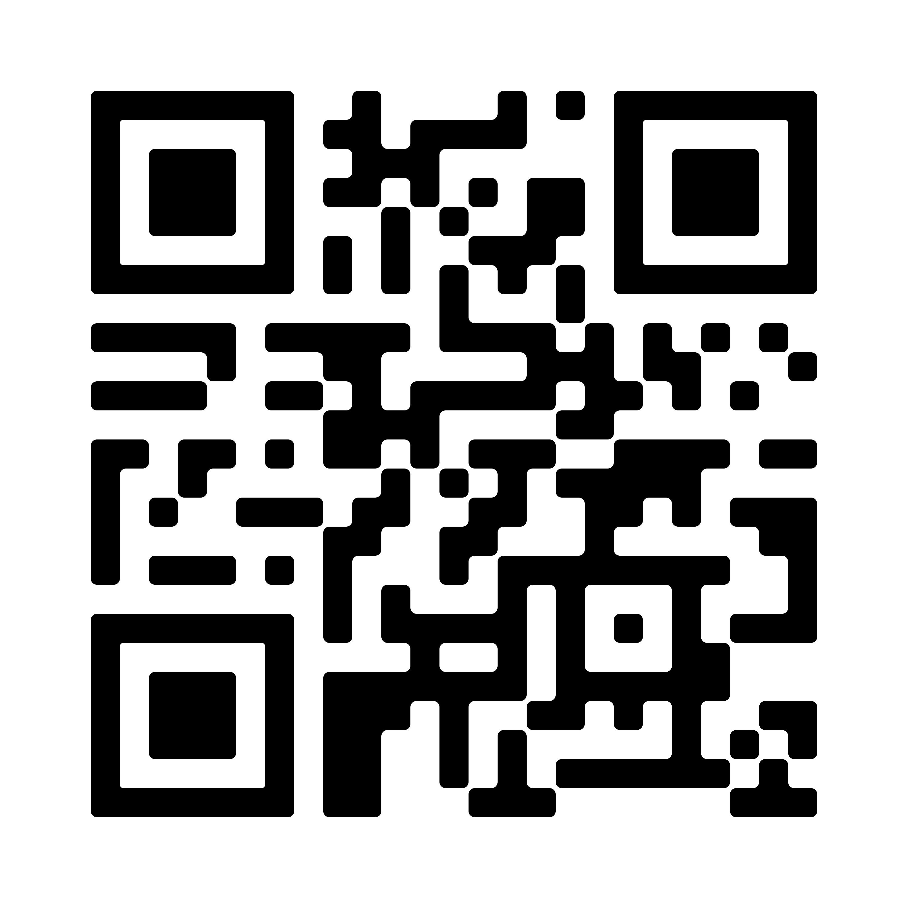

CREATEH
FEST
ER
About Me:
Hello!!

Slide 3



“Thank you for being here!”

Slide 4

.

Slide 5
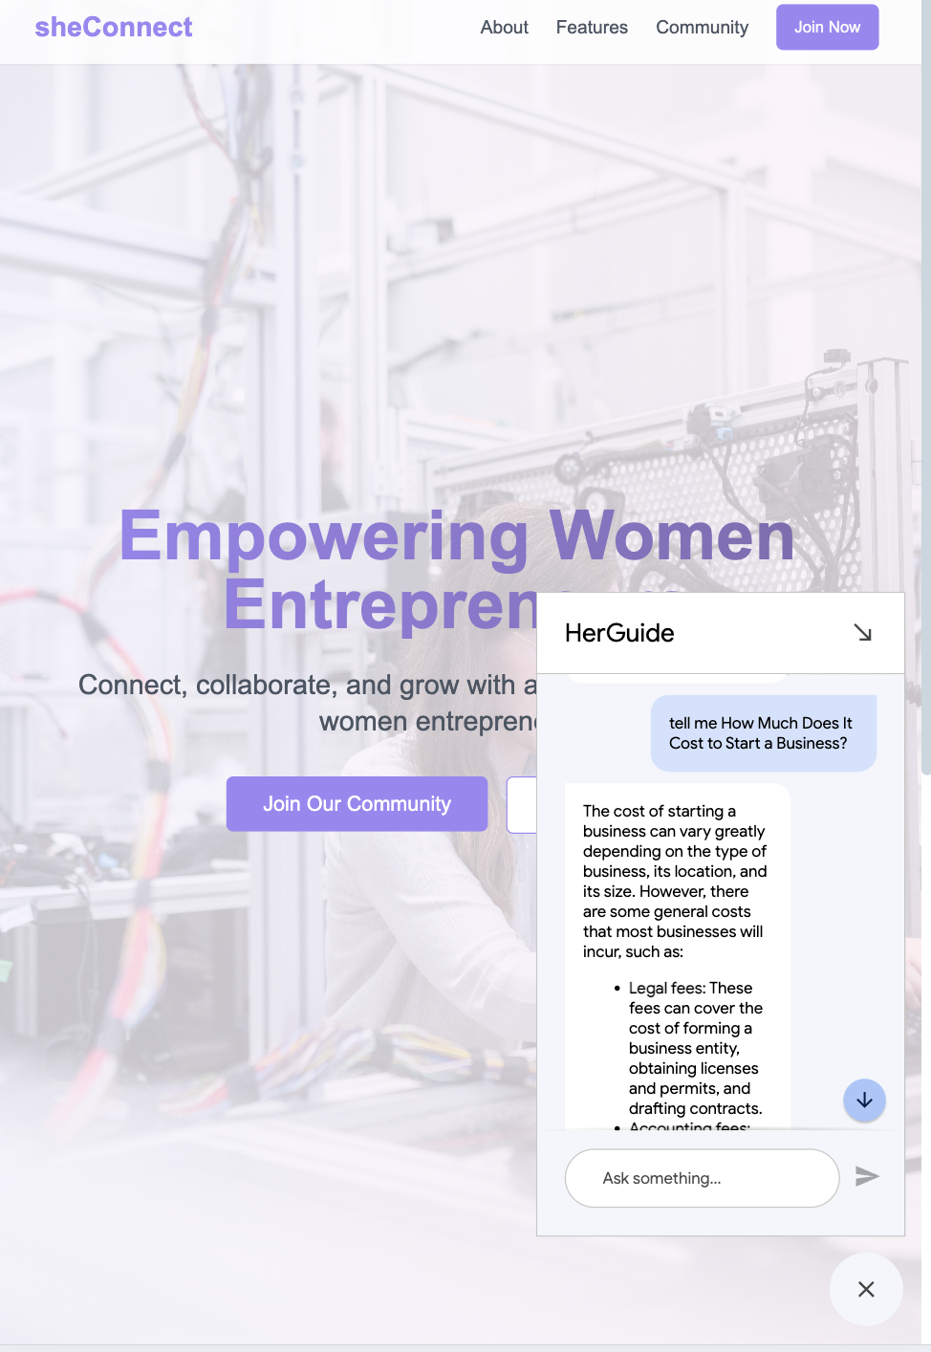
CREATEH
Screenshot 2025-01-29 at 4.15.35 AM
FEST
ER
.
Result

Slide 6

CREATEH
FEST
ER
Agenda:
01
Google Cloud Platform (GCP)
02
Create an app on Vertex AI
03
Train your chatbot on our own data
04
ChatBot Deployment
05
Simulation and Testing

Slide 7


CREATEH
FEST
ER
Creating a GCP Account
Key Points:
Sign in for a free trial on a google account and enable APIs
Create an App and feed training data
Create an application on Agent Builder and design it by DilogflowCX
Build a chatBot for a website
Use your built chatBot for a particular website

Slide 8

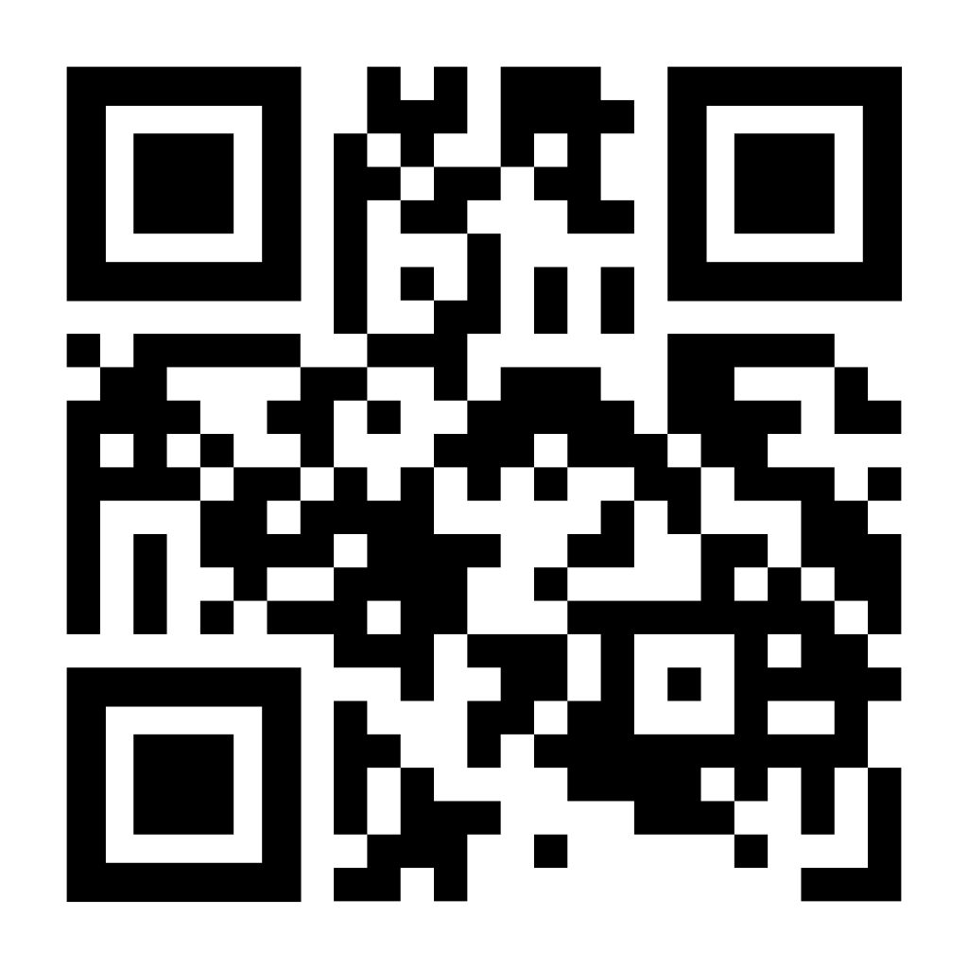
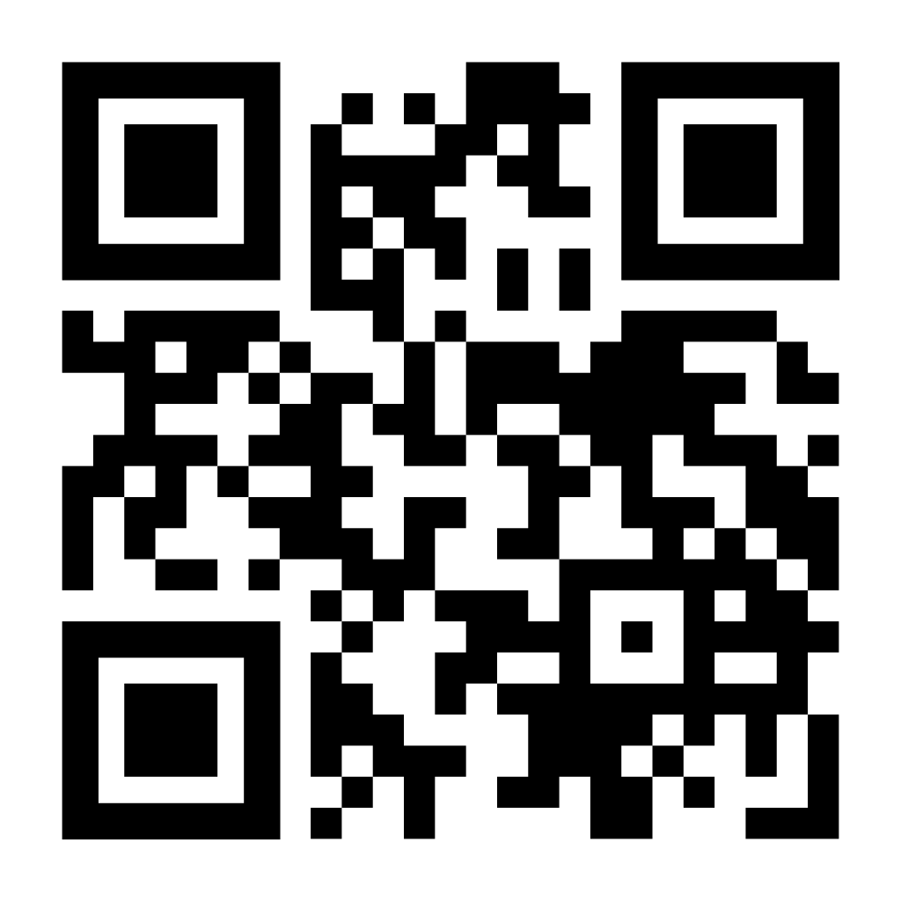
CREATEH
FEST
ER
Documents of the chatBot:
ChatBot Walkthrough - Blog
ChatBot Github Repo

Slide 9



CREATEH
FEST
ER
03
01
02
Vertex AI and Dialogflow make AI chatbot
development accessible for all.
Minimal coding required— focus on integrating
datasets and refining LLMs.
AI-powered chatbots can provide precise,
personalized, and
actionable information.

Slide 10

CREATEH
FEST
ER
Sample Questions:
Tips for Applying for a Female-Owned Business Grant
How Much Does it cost to start a Business?
My business has already raised funding, but we’re still in the prototype phase. Can I apply for the Amber Grant or should I look for other options?
My business has a working prototype but hasn’t yet been commercialized. Which grants are suitable for this stage?

Slide 11
CREATEH
FEST
ER
THANK YOU!!!

